Slide 1
SmartShop – E-Commerce Platform

Slide 2

Project Vision (Product Owner)
Vision Statement:
easy-to-use E-commerce platform that enables users to browse products, purchase online, and manage their orders seamlessly
Goals:
User registration & login
Browse products
Shopping cart
Checkout (future)
Admin dashboard
Responsive UI/UX
Business Goals:
- Smooth shopping experience
- Secure login & account management
- Easy product browsing & purchasing
- Admin tools for inventory & sales
Stakeholders:
- Customers
- Admins
- Scrum Team
- Product Owner
- Scrum Master

Slide 3
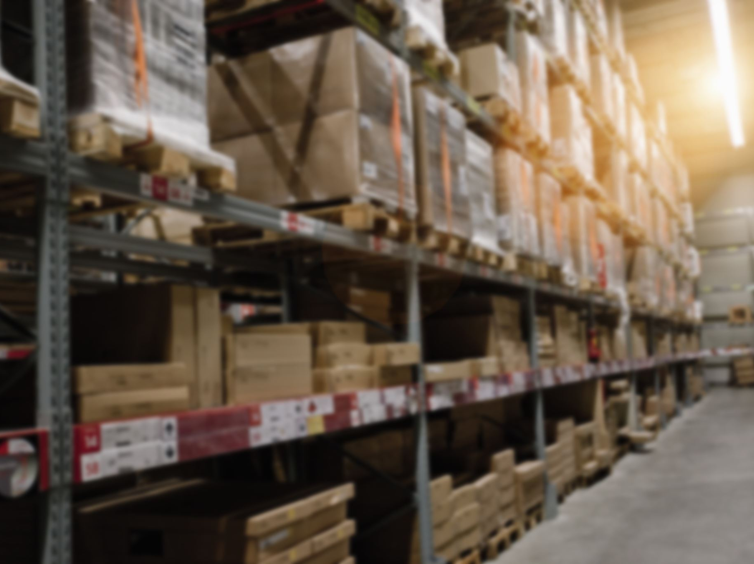
Product Backlog (Product Owner)
US1: Sign Up (Must)
US2: Login (Must)
US3: Browse Products (Must)
US4: Add to Cart (Must)
US5: Search Products (Should)
US6: Checkout (Must)
US7: Track Orders (Should)
US8: Wishlist (Could)
US9: Review Products (Could)
US10: Admin – Add Products (Must)
US11: Admin – Edit Products (Must)
US12: Admin – Delete Products (Must)
US13: Admin – View Sales Reports (Should)

Slide 4
User Story #1
User Story ID | US #1
User Story Name | User Sign-up
Actors | User (Customer)
Description | As a user I’d like to be able to sign up to the application So that I can create an account and access its services
Pre condition | User is not registered
Post condition | A new user account is created in the system. User receives a confirmation message/email.
Acceptance Criteria | Given I’m a new user on the sign-up page When I fill in valid information (email, username, password) and click “Sign Up” Then the system creates my account and shows a confirmation message

Slide 5
User Story #2
User Story ID | US #2
User Story Name | User Login
Actors | User (Customer)
Description | As a user I'd like to be able to login to the application So that I can sign in and access its services
Pre condition | User has an active registered account.
Post condition | User is authenticated and redirected to the homepage/dashboard. Invalid attempts are logged and appropriate error messages displayed
Acceptance Criteria | Given I am a registered user on the login page, When I enter valid credentials, Then I should be successfully logged in and redirected to the homepage. Given I enter invalid credentials, When I attempt to log in, Then the system should reject the login and display an error message.

Slide 6
User Story #3
User Story ID | US #3
User Story Name | Browse Products
Actors | User (Customer)
Description | As a user I’d like to browse products So that I can explore available items
Pre condition | Products are available in the system catalog.
Post condition | Product catalog is displayed with details (name, price, image).
Acceptance Criteria | Given I am on the product catalog page, When I browse the store, Then I should see a list of available products with details (name, price, image). And products should be paginated or scrollable if the list is large.

Slide 7
User Story #4
User Story ID | US #4
User Story Name | User Add to Cart
Actors | User (Customer)
Description | As a customer, I want to add items to my cart so that I can purchase them later.
Pre condition | User is logged in
Post condition | Product is added to cart.
Acceptance Criteria | Given I am on a product page, When I click "Add to Cart", Then the product is added to my cart.

Slide 8
User Story #5
User Story ID | US #5
User Story Name | User Search Products
Actors | User (Customer)
Description | As a customer I’d like to be able to search products So that I can quickly find what I need.
Pre condition | Products exist in catalog.
Post condition | Search results are displayed.
Acceptance Criteria | Given I am on the catalog page When I enter a search keyword Then products matching the query are displayed.

Slide 9
User Story #6
User Story ID | US #6
User Story Name | Checkout
Actors | User (Customer)
Description | As a customer I’d like to be able to checkout So that I can complete my purchase.
Pre condition | User has items in cart.
Post condition | Order is placed successfully.
Acceptance Criteria | Given I have items in my cart When I proceed to checkout and provide shipping/payment details Then my order is confirmed.

Slide 10
User Story #7
User Story ID | US #7
User Story Name | User Track Orders
Actors | User (Customer)
Description | As a customer I’d like to be able to track my orders So that I can monitor delivery progress
Pre condition | User has placed an order
Post condition | Order status is displayed.
Acceptance Criteria | Given I have placed an order When I visit "My Orders" Then I should see the current status (processing, shipped, delivered).

Slide 11
User Story #8
User Story ID | US #8
User Story Name | User Wishlist
Actors | User (Customer)
Description | As a customer I’d like to be able to add products to a wishlist So that I can save them for later.
Pre condition | User is browsing products. User is logged in
Post condition | Item is stored in wishlist.
Acceptance Criteria | Given I am browsing products When I click "Add to Wishlist" Then the product is saved to my wishlist.

Slide 12
User Story #9
User Story ID | US #9
User Story Name | User Review Products
Actors | User (Customer)
Description | As a customer I’d like to be able to review products So that I can share my experience with others.
Pre condition | User has purchased a product.
Post condition | Review is visible on product page.
Acceptance Criteria | Given purchased a product When I submit a review with text/rating Then tit is displayed on the product page.

Slide 13
User Story #10
User Story ID | US #10
User Story Name | Admin Add Products
Actors | Admin
Description | As an admin I’d like to be able to add products So that hey appear in the catalog
Pre condition | Admin is logged in.
Post condition | New product is added to catalog.
Acceptance Criteria | Given I am an admin When I enter product details (name, price, stock, image), Then the product is added to catalog.

Slide 14
User Story #11
User Story ID | US #11
User Story Name | Admin Edit Products
Actors | Admin
Description | As an admin I’d like to be able to edit products So that catalog details are updated
Pre condition | Product exists in catalog
Post condition | Product details are updated.
Acceptance Criteria | Given I am an admin When I update product details Then the changes are saved and reflected in catalog.

Slide 15
User Story #12
User Story ID | US #12
User Story Name | Admin Delete Products
Actors | Admin
Description | As an admin I’d like to be able to delete products So that unavailable items are removed
Pre condition | Product exists in catalog.
Post condition | Product is removed from catalog.
Acceptance Criteria | Given I am an admin When I delete a product Then it is removed from the catalog.

Slide 16
User Story #13
User Story ID | US #13
User Story Name | Admin View Sales Reports
Actors | Admin
Description | As an admin I’d like to be able to view sales reports So that I can analyze business performance
Pre condition
Post condition | Reports are generated and displayed.
Acceptance Criteria | Given I am an admin When I access the reports dashboard Then I can view sales statistics (orders, revenue, best-selling products).

Slide 17

Sprint 1 Goal
Sprint Goal: Deliver entry point for users (Sign Up, Login, Browse Products)
Selected User Stories:
- US1: Sign Up
- US2: Login
- US3: Browse Products

Slide 18
User Story #1
User Story ID | US #1
User Story Name | User Sign-up
Actors | User (Customer)
Description | As a user I’d like to be able to sign up to the application So that I can create an account and access its services
Pre condition | User is not registered
Post condition | A new user account is created in the system. User receives a confirmation message/email.
Acceptance Criteria | Given I’m a new user on the sign-up page When I fill in valid information (email, username, password) and click “Sign Up” Then the system creates my account and shows a confirmation message

Slide 19
User Story #2
User Story ID | US #2
User Story Name | User Login
Actors | User (Customer)
Description | As a user I'd like to be able to login to the application So that I can sign in and access its services
Pre condition | User has an active registered account.
Post condition | User is authenticated and redirected to the homepage/dashboard. Invalid attempts are logged and appropriate error messages displayed
Acceptance Criteria | Given I am a registered user on the login page, When I enter valid credentials, Then I should be successfully logged in and redirected to the homepage. Given I enter invalid credentials, When I attempt to log in, Then the system should reject the login and display an error message.

Slide 20
User Story #3
User Story ID | US #3
User Story Name | Browse Products
Actors | User (Customer)
Description | As a user I’d like to browse products So that I can explore available items
Pre condition | Products are available in the system catalog.
Post condition | Product catalog is displayed with details (name, price, image).
Acceptance Criteria | Given I am on the product catalog page, When I browse the store, Then I should see a list of available products with details (name, price, image). And products should be paginated or scrollable if the list is large.

Slide 21
Use Case Diagram (Analysis Lead)
Actors: Customer
Use Cases: Sign Up, Login, Browse Products
(Add UML diagram image here)

Slide 22
Wireframes / Mockups (UI/UX Lead)
Screens:
- Sign Up Page
- Login Page
- Browse Products Page
(Add mockup images here)

Slide 23
Scrum Board (Scrum Master)
Add screenshot of Scrum/clickUp
Tasks for US1, US2, US3

Slide 24
Definition of Done (Team Agreement)
A user story is 'Done' when:
Implemented(use case)
- Implemented (UI/Mockup)
- Acceptance criteria met
- Approved by Product Owner

Slide 25
Conclusion (Team)
Sprint 1 delivered:
- Sign Up
- Login
- Browse Products
This establishes foundation for Sprint 2 (Cart, Checkout, Search).

Slide 26
Release Plan
Release | Features / Deliverables
Release 1 (MVP) | User Registration, Login, Browse Products
Release 2 | Checkout, Search Products, Add to Cart
Release 3 | Track Orders, Wishlist, Review Products
Release 4 | Admin Management (Add/Edit/Delete Products, View Reports)

